Slide 1


Slide 2
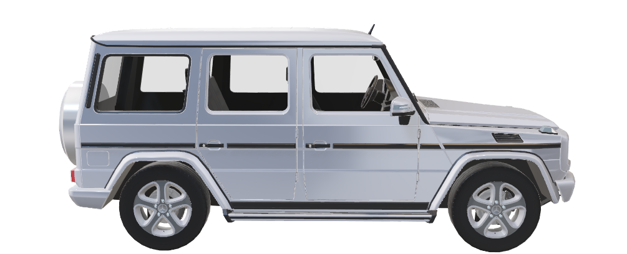
Mercedes-Benz G55
Mercedes-Benz G55

Slide 3
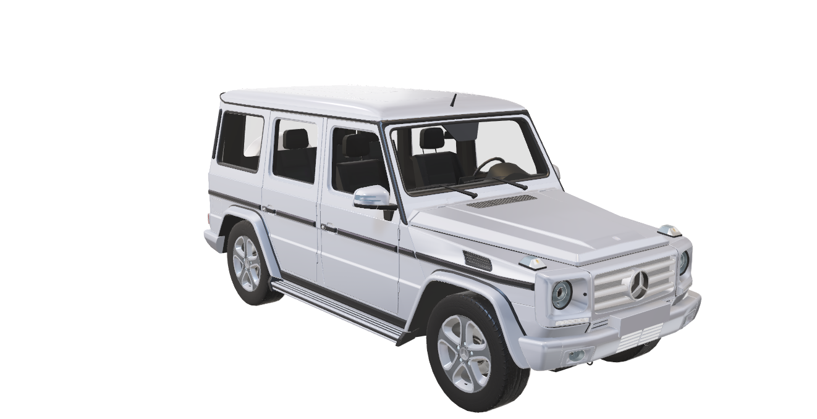
Mercedes-Benz
Mercedes-Benz G55
This model was produced
in 2011 in Germany. Its
name Mercedes-benz G55
AMG 4rd features
    DETAILS
500
HOURSEPOWER
5.5L
LITERES
332
CUBIC INCHES

Slide 4
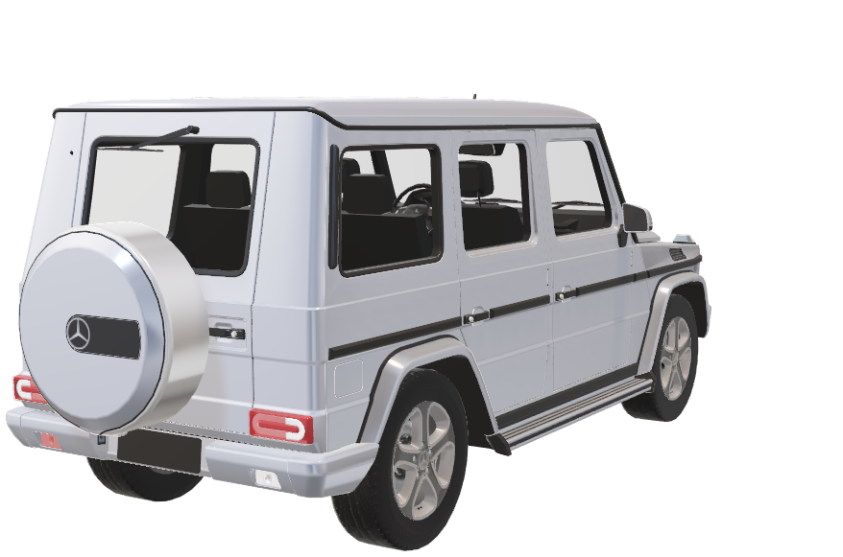
This model was produced in 2011
in Germany. Its name Mercedes-
Benz G55 AMG 4rd features
Mercedes-Benz G55
Timeless design,
Contemporary
Interpretation.
    DETAILS
500
HOURSEPOWER
5.5L
LITERES
The shape of the G55 is
Unmistakable because of iconic
flyline and roof lines
332
CUBIC INCHES

Slide 5
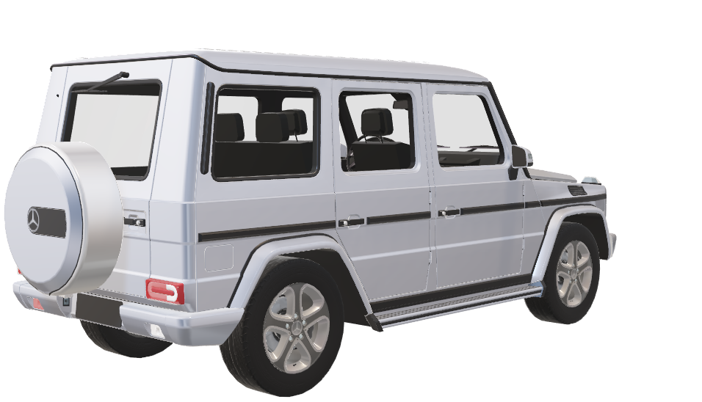
The harmony of tradition and modernity- the iconic flyline and the continuous light strip
This model was produced in 2011
in Germany. Its name Mercedes-
Benz G55 AMG 4rd features
    DETAILS
500
HOURSEPOWER
5.5L
LITERES
332
CUBIC INCHES

Slide 6
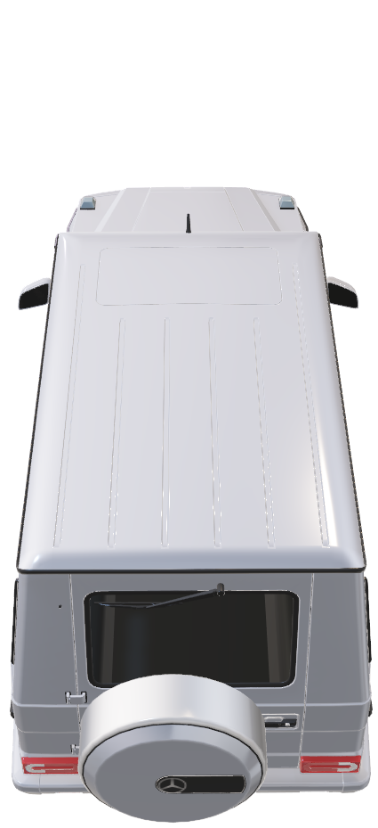
    DETAILS
Mercedes-Benz G55
500
HOURSEPOWER
5.5L
LITERES
This model was produced in 2011
in Germany. Its name Mercedes-
Benz G55 AMG 4rd features
5.5L
LITERES

Slide 7
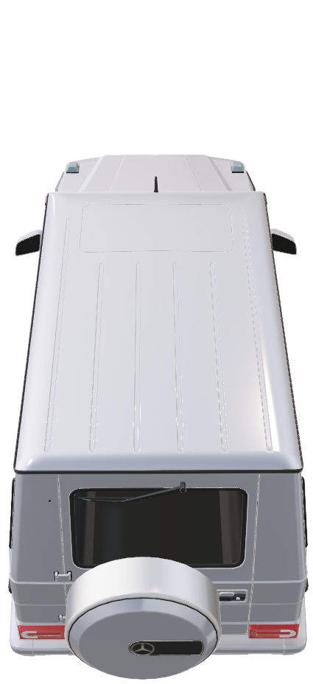
    DETAILS
Mercedes-Benz G55
500
HOURSEPOWER
5.5L
LITERES
This model was produced in 2011
in Germany. Its name Mercedes-
Benz G55 AMG 4rd features
5.5L
LITERES

